Slide 1

Introduction to Data Analysis (DATA 1200) Assignment #4 – SVM and Naïve Bayes model Professor: Omar Altrad
Prepared by Group – 6
Sheetalben Mukeshbhai Jadav - 100951636
Karthic Easwar Sivapragasam - 100963337
Denish Surati - 100897255
Sayali Kumbhar - 100950732

Slide 2
Contents
What is SVM Model?
What is Naïve Bayes Model ?
Description of Analysis
Comparison in both models
Recommendation and Justification on model selection

Slide 3
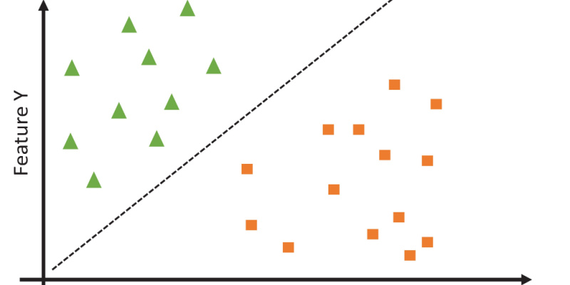
SVM Model
In machine learning, SVM is used to classify data by finding the optimal decision boundary that maximally separates different classes. It aims to find the best hyperplane that maximizes the margin between support vectors, enabling effective classification even in complex, non-linear scenarios.

Slide 4
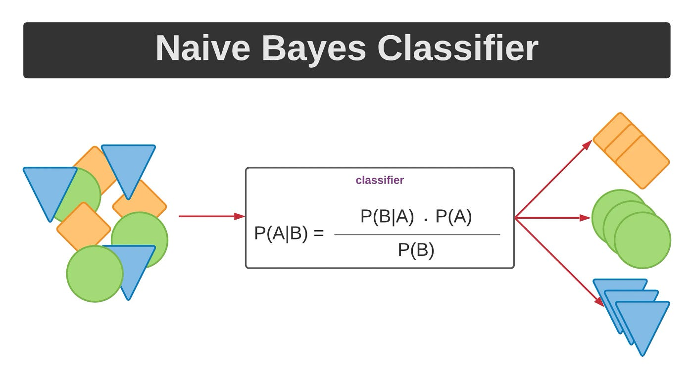
Naïve Bayes Model
Naive Bayes is a simple technique for constructing classifiers: models that assign class labels to problem instances, represented as vectors of feature values, where the class labels are drawn from some finite set.

Slide 5
 | Age | Sex | BP | Cholesterol | Na_to_K
count | 200.000000 | 200.000000 | 200.000000 | 200.000000 | 200.000000
mean | 44.315000 | 0.480000 | 1.090000 | 0.515000 | 16.084485
std | 16.544315 | 0.500854 | 0.821752 | 0.501029 | 7.223956
min | 15.000000 | 0.000000 | 0.000000 | 0.000000 | 6.269000
25% | 31.000000 | 0.000000 | 0.000000 | 0.000000 | 10.445500
50% | 45.000000 | 0.000000 | 1.000000 | 1.000000 | 13.936500
75% | 58.000000 | 1.000000 | 2.000000 | 1.000000 | 19.380000
max | 74.000000 | 1.000000 | 2.000000 | 1.000000 | 38.247000
Three insights of the Dataset
1. Mean Age and Gender Distribution:
Average age: 44.315 years; gender distribution: 48% male, 52% female (based on statistics provided, assuming 0 for male and 1 for female). Conclusion: The majority of the dataset's members are middle-aged, and the distribution of males and females is nearly equal. The context provided by this demographic data helps to understand health-related variables such as blood pressure (BP), cholesterol, and the sodium-to-potassium ratio (Na_to_K).

Slide 6
Three insights of the Dataset
2. Blood Pressure and Cholesterol Levels:
Average age: 44.315 years; gender distribution: 48% male, 52% female (based on statistics provided, assuming 0 for male and 1 for female). Conclusion: The majority of the dataset's members are middle-aged, and the distribution of males and females is nearly equal. The context provided by this demographic data helps to understand health-related variables such as blood pressure (BP), cholesterol, and the sodium-to-potassium ratio (Na_to_K).
3. Sodium-to-Potassium Ratio (Na_to_K):
Na_to_K Mean: 16.084485
7.223956 is the standard deviation (Na_to_K). Understanding: The ratio of sodium to potassium is a crucial metric for evaluating cardiovascular health. The dataset may, on average, tend towards greater salt levels relative to potassium, according to the mean value of about 16. The 7.22 standard deviation shows a significant range around this mean, suggesting that there may be differences in the people's eating patterns or medical issues. These insights offer a quick overview of the important health metrics and demographic makeup of the dataset, laying the groundwork for additional research or deductions about the state of health of the people it represents.

Slide 7
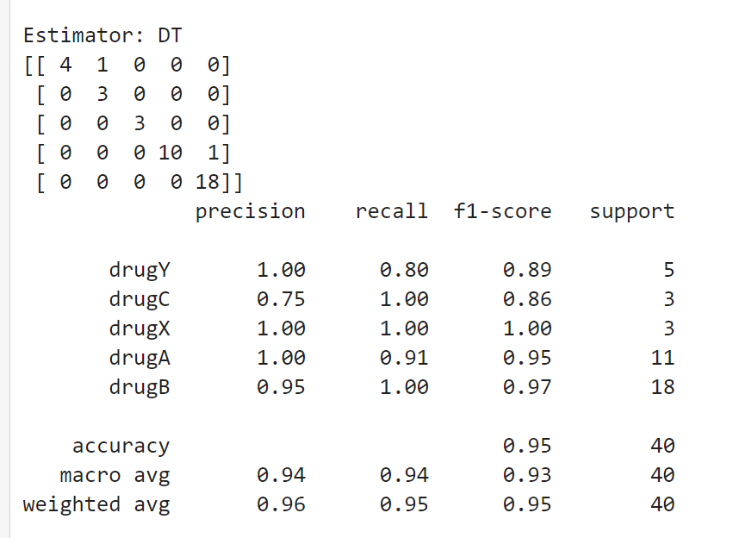
Neural Network Algorithm key metrics
The provided metrics and confusion matrix are from a classification model evaluation, likely a neural network, that predicts the type of drug based on certain features. Let's interpret the key metrics: precision, recall, and F1-score.
Real classes are represented by rows.
Predicted classes are represented by columns.
Precision: Precision is a metric for positive forecast accuracy. The ratio of true positives (TP) to the total of true positives and false positives (FP) is used to compute it.
Recall: The percentage of true positives that are accurately identified is measured by recall. The ratio of true positives (TP) to the total of false negatives (FN) is used to compute it.

Slide 8
Neural Network Algorithm key metrics
Precision: The precision of positive forecasts is measured. It is expressed as the ratio of true positive predictions to all positive predictions (true positives + false positives) for each class. drugY: Precision = 1.00 - This indicates that the model predicts drugY 100% of the time with 100% accuracy. drugC: 0.75 precision When the model predicts drugC, it gets it right 75% of the time. drugX: Precision = 1.00 - Every time it forecasts drugX, it gets it right. drugA: Precision = 1.00 - Every time it forecasts drugA, it does it properly. drugB: Precision = 0.95 - 95% of the time, the model predicts drugB correctly, and hence, drugB is identified.
Recall: The Recall is a statistical measure that quantifies the proportion of true positive predictions to the total number of positive instances (true positives plus false negatives). drugY: Recall = 0.80 - Eighty percent of the drugY cases are correctly identified by the model. drugC: Recall = 1.00 - All occurrences of drugC are accurately identified. drugX: Recall = 1.00 - All occurrences of drugX are accurately identified. drugA: Recall = 0.91 - 91% of the drugA cases are properly identified by it. drugB: Recall = 1.00 - All occurrences of drugB are accurately identified.

Slide 9
Neural Network Algorithm key metrics
F1-score: This is a single metric that balances both measures; it is the harmonic mean of precision and recall. F1-scores for drugY, drugC, and drugX are as follows: F1-score = 1.00, drugA, F1-score = 0.95, and drugB, F1-score = 0.97.
Explanation:
Precision: The Neural Network approach (with DT estimator) demonstrates good accuracy in most classes, meaning that it generally gets predictions right. This is particularly true for drugs Y, X, and A. Recall: The algorithm performs well in all classes, but it excels in drug C and drug B the most, where it accurately detects every instance.
F1-score: The F1-scores are often high, signifying strong overall memory and accuracy performance. Notably, drugX obtains an F1-score of 1.00, which is ideal for that class and shows an ideal balance between recall and precision. All things considered, the Neural Network method with the DT estimator performs well on all measures, showing especially excellent recall and precision in the majority of classes, indicating its capacity to accurately categorise cases into the appropriate medication categories.

Slide 10
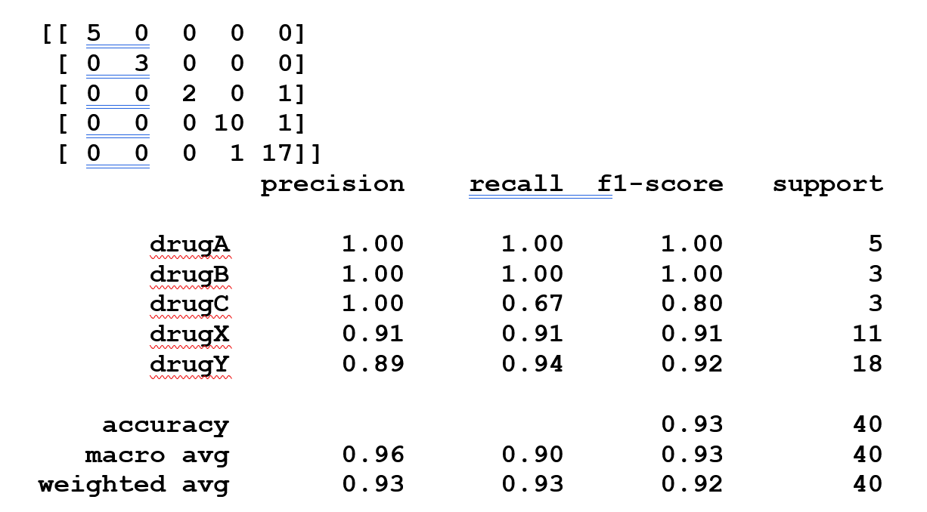
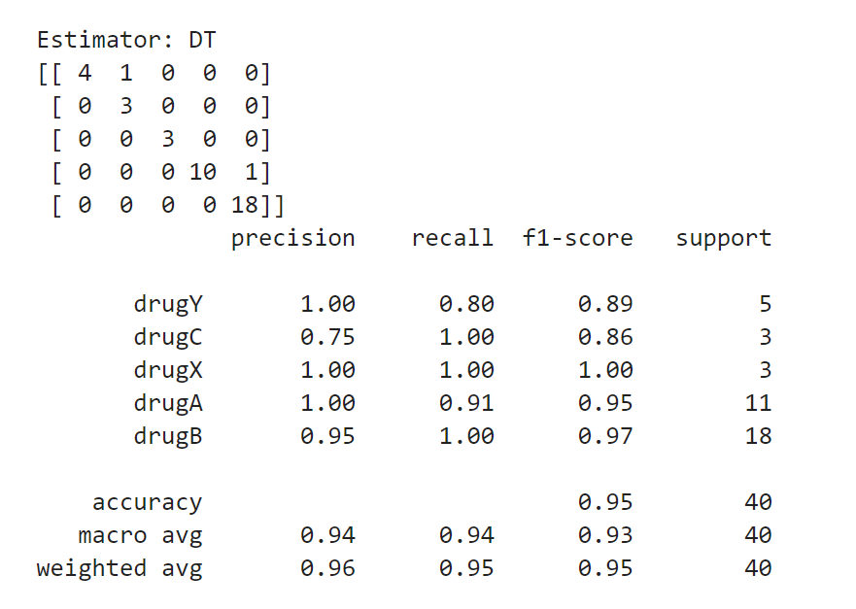
Comparison of the key metrics of Neural Network Algorithm to Logistical Regression Algorithm
Logistical Regression Algorithm
Based on the supplied confusion matrices and classification reports, let's compare the three main metrics (precision, recall, and F1-score) between the Logistic Regression and Neural Network techniques.
Neural Network Algorithm

Slide 11
Comparison of the key of Neural Network Algorithm to Logistical Regression Algorithm key metrics
Metrics for Neural Network Algorithms:
Precision: drugA: 1.0 - drugX: 1.00 - drugY: 1.00 - drugB: 0.95 - drugC: 0.75
Recall: drugA: 0.91 - drugB: 1.00 - drugC: 1.00 - drugX: 1.00 - drugY: 0.80
F1-score: drugA: 0.95 - drugB: 0.97 - drugC: 0.86 - drugX: 1.00 - drugY: 0.89
Metrics for the Logistic Regression Algorithm:
Precision: drugA: 1.00 - drugB: 1.00 - drugC: 1.00 - drugX: 0.91 - drugY: 0.89 Recall: drugA: 1.00 - drugB: 1.00 - drugC: 0.67 - drugX: 0.91 - drugY = 0.94 F1-score: drugA: 1.00 - drugB: 1.00 - me drugC dicationC: 0.80 - drugX: 0.91 - drugY = 0.92

Slide 12
Comparison of the key of Neural Network Algorithm to Logistical Regression Algorithm key metrics
Precision: - In general, logistic regression is more precise than neural networks in all classes, with the exception of drug B, where neural networks are somewhat more precise (0.95 vs 1.00).
Recall: When compared to Logistic Regression, Neural Network exhibits a higher recall for drugs A, B, and C. For medication Y, Logistic Regression has a higher recall.
F1-score: Generally speaking, neural networks outperform other methods in all classes, but especially in drugA, drugB, and drugX classes.
In summary, logistic regression consistently outperforms neural networks in terms of precision and recall, while it performs marginally worse in terms of F1-score.
Neural Network: - Performs better overall in terms of F1-score, particularly for drugs A, B, and X.
In summary, based on the provided metrics, the Neural Network approach outperforms Logistic Regression in terms of overall performance as measured by the F1-score and achieves equivalent or greater precision and recall in the majority of classes.

Slide 13
Three ways to help improve the performance of the Neural Network model.
Here are three methods to enhance the performance of the Neural Network model with a Decision Tree estimator, based on the confusion matrix and performance metrics: 1. Modulating Model Complexity:
Elucidation: Choice Trees are perceptive of their intricacy and depth. In order to achieve poor generalisation on unseen data, a deep tree may overfit the training set, whereas a shallow tree may underfit. Action: Try varying the maximum depth, the minimum number of samples per leaf, and the maximum number of characteristics that are taken into account during splitting. Find the ideal balance between reducing overfitting and increasing generalisation using strategies like cross-validation. This will enhance precision, recall, and F1-score for all classes.
2. Selection and Feature Engineering:
Justification: The effectiveness of decision tree-based models is strongly influenced by the features' relevancy and quality. The model's predictive potential can be diminished by irrelevant or noisy features that can lead to errors. Action: To find and eliminate features that are unnecessary, perform a complete feature analysis. Additionally, investigate methods such as feature transformation (e.g., PCA), normalisation, and scaling to enhance the interpretability and efficacy of the model's feature set. The decision tree might potentially improve overall performance metrics by making more accurate and dependable forecasts by concentrating on the most informative elements.

Slide 14
Three ways to help improve the performance of the Neural Network model.
3. Company Education:
Application: Several models are combined in ensemble methods to increase forecast resilience and accuracy. When compared to single models, they can lower bias and variance, improving overall performance.
Action: Use group methods like AdaBoost, Gradient Boosting Machines (GBM), and Random Forests. These techniques take advantage of the advantages of many decision trees by sequential boosting (GBM, AdaBoost) or averaging (Random Forests). Through the use of ensemble approaches, metrics including as accuracy, precision, recall, and F1-score can be improved across a variety of classes by improving the model's capacity to generalise and produce correct predictions.
Synopsis: Refine feature engineering to improve the quality and relevance of input data, optimise model complexity to balance underfitting and overfitting, and possibly use ensemble learning techniques to combine the advantages of multiple models to improve the performance of the Neural Network model based on a Decision Tree estimator. By addressing possible flaws in precision, recall, and F1-score measures, these solutions together seek to improve overall accuracy and dependability in drug categorization tasks.

Slide 15

Thank you

